Slide 1
Uber Data Analysis Insights
Understanding Travel Patterns through Uber Data
Photo by Pexels

Slide 2
Table of Contents
01
Project Overview
02
Dataset Overview
03
Handling Missing Data
04
Encoding and Scaling
05
Modeling Approaches
06
Evaluation Metrics
07
Visualization Insights
08
Conclusions & Future Work

Slide 3

1
Project Overview
Analyzing Uber trip logs to understand travel patterns and distances, exploring 1156 trip records with key features like trip dates, mileage, and categories.
Insightful analysis uncovering travel behavior through Uber data, shedding light on trip types, distances, and purposes for both personal and business needs.
Extracting valuable insights from Uber trip data to reveal trends and patterns, providing a deep dive into travel behavior, distances covered, and trip purposes.
Photo by Pexels

Slide 4

2
Key Features
Dataset Overview
The dataset includes features like START_DATE, END_DATE, CATEGORY, START/STOP locations, MILES covered, and trip PURPOSE.
Features include essential trip details such as start and end times, trip categories, locations, distances covered, and the purpose behind each trip.
Photo by Pexels

Slide 5
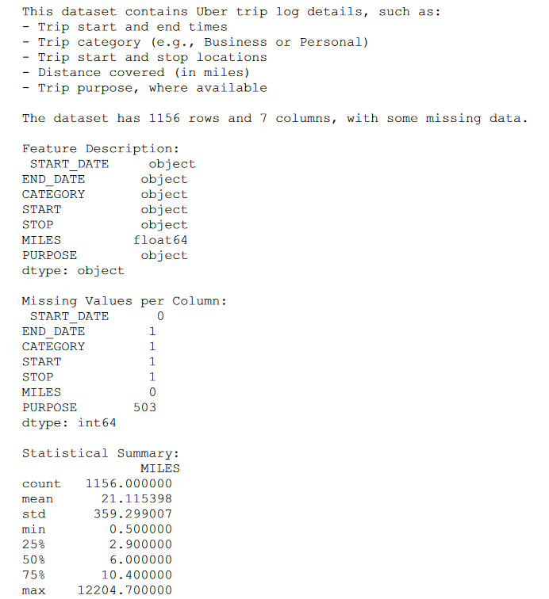
2
Key Features
Dataset Overview
Photo by Pexels

Slide 6
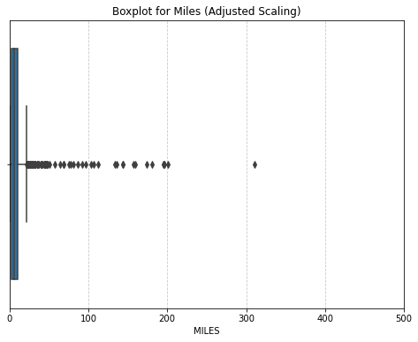
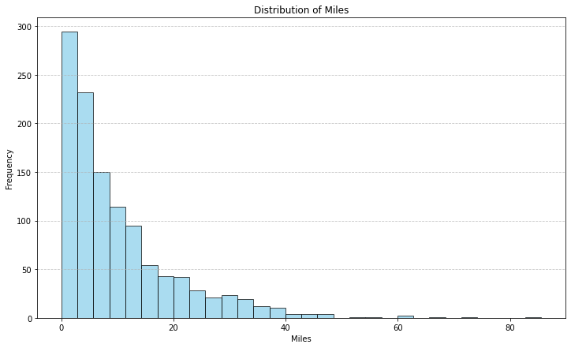

2
Key Features
Dataset Overview
Photo by Pexels

Slide 7

3
Data Cleansing
Handling Missing Data
Removed rows with critical missing values and implemented 'Unknown' imputation for missing trip purpose entries.
Applying data cleansing techniques to handle missing values, ensuring data integrity by dropping rows with crucial information gaps.
Strategies for managing missing data, including deletion of incomplete entries and imputation of missing trip purposes with 'Unknown' values.
Ensuring data quality by addressing missing values through deletion and imputation techniques, maintaining the dataset integrity.
Photo by Pexels

Slide 8
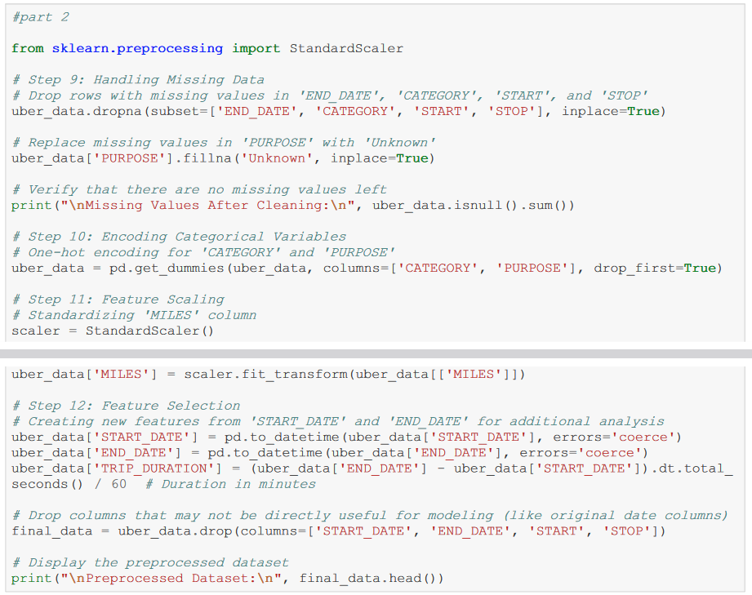
3
Data Cleansing
Handling Missing Data
Photo by Pexels

Slide 9
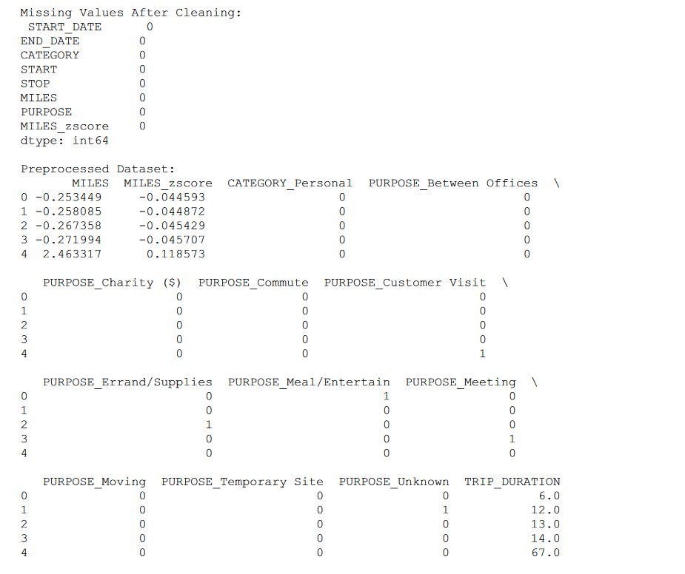
3
Data Cleansing
Handling Missing Data
Photo by Pexels

Slide 10

4
Data Transformation
Encoding and Scaling
Applied one-hot encoding for CATEGORY and PURPOSE, standardized MILES using standard scaling for normalization.
Transforming categorical features (CATEGORY and PURPOSE) using one-hot encoding and standardizing distance values (MILES) for consistency through standard scaling.
Photo by Pexels

Slide 11
5
Algorithm Selection
Modeling Approaches
Model Implementation Summary:
Classification (Trip Type):
Primary: Logistic Regression with hyperparameter tuning (C: 0.01-100)
Secondary: Random Forest Classifier for comparison
Regression (Miles Prediction):
Linear Regression with 5-fold cross-validation
Photo by Pexels

Slide 12

6
Performance Analysis
Evaluation Metrics
Evaluate models based on accuracy: Logistic Regression 94%, Random Forest 92%, and recall: Logistic (0.07), Random Forest (0.13).
Photo by Pexels

Slide 13
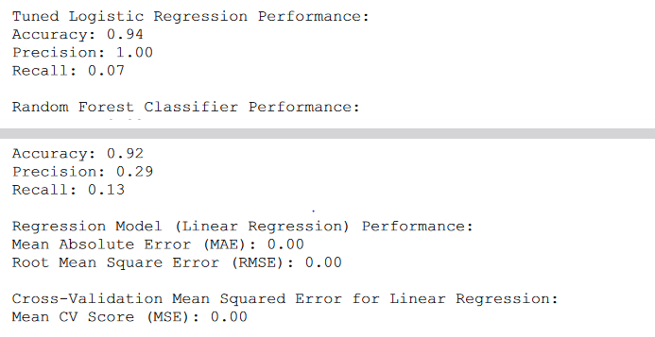
Photo by Pexels

Slide 14

7
Visual Representation
Visualization Insights
Key visuals include a Histogram of MILES illustrating trip distance distribution and a Bar Plot highlighting trip categories for visual insights.
Photo by Pexels

Slide 15
7
Visual Representation
Visualization Insights
Photo by Pexels

Slide 16
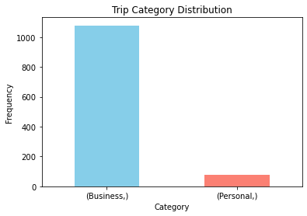
7
Visual Representation
Visualization Insights
Photo by Pexels

Slide 17
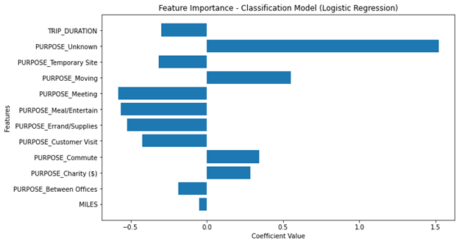
7
Visual Representation
Visualization Insights
Photo by Pexels

Slide 18
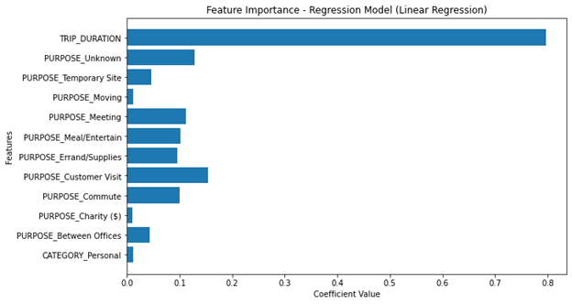
7
Visual Representation
Visualization Insights
Photo by Pexels

Slide 19
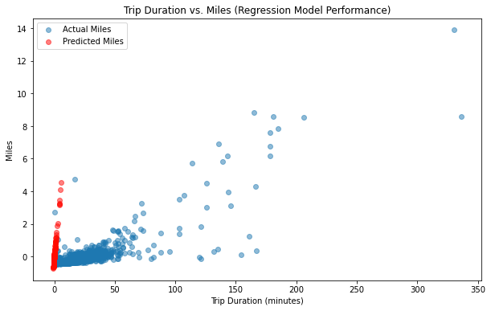
7
Visual Representation
Visualization Insights
Photo by Pexels

Slide 20

8
Key Takeaways
Conclusions & Future Work
Reveals short trip prevalence and class imbalance, highlighting the need for improved recall in Logistic Regression for Personal trips.
Photo by Pexels

